Slide 1

Marketing Data Analysis
By:
Abhijeet Ranjan

Slide 2
Marketing Strategy
Optimization
Analysis
Presentation

Slide 3
Objectives
Are there any null values or outliers? How will you handle them?
What factors are significantly related to the no. of web purchases?
Which marketing campaign was the most successful?
What does the avg. customer look like?
Which products are performing best?
Which channels are under performing?

Slide 4
Overview
Marketing campaign data of 2,240 customers of Maven Marketing, including customer profiles, product preferences, campaign successes/failures, and channel performance.
Analysis
Result of analysis is describe various elements of our target audience- demographic and psychographics- and discovering better channels to improve future sales. By this way we can determine patterns, relationships or trend.

Slide 5
Are there any null values or outliers? How will you handle them?
There are "24" Null values found in "Income" column by using COUNTBLANK formula to handle them we can use different methods first we can drop values If the percentage of missing values is relatively small and it does not affect the representativeness of your sample or Second Imputation involves filling in missing values with estimated values based on the available data. There are different methods to impute missing values, such as mean imputation, median imputation, mode imputation, regression imputation. in this data we have used "Mean" to replace blank values

Slide 6
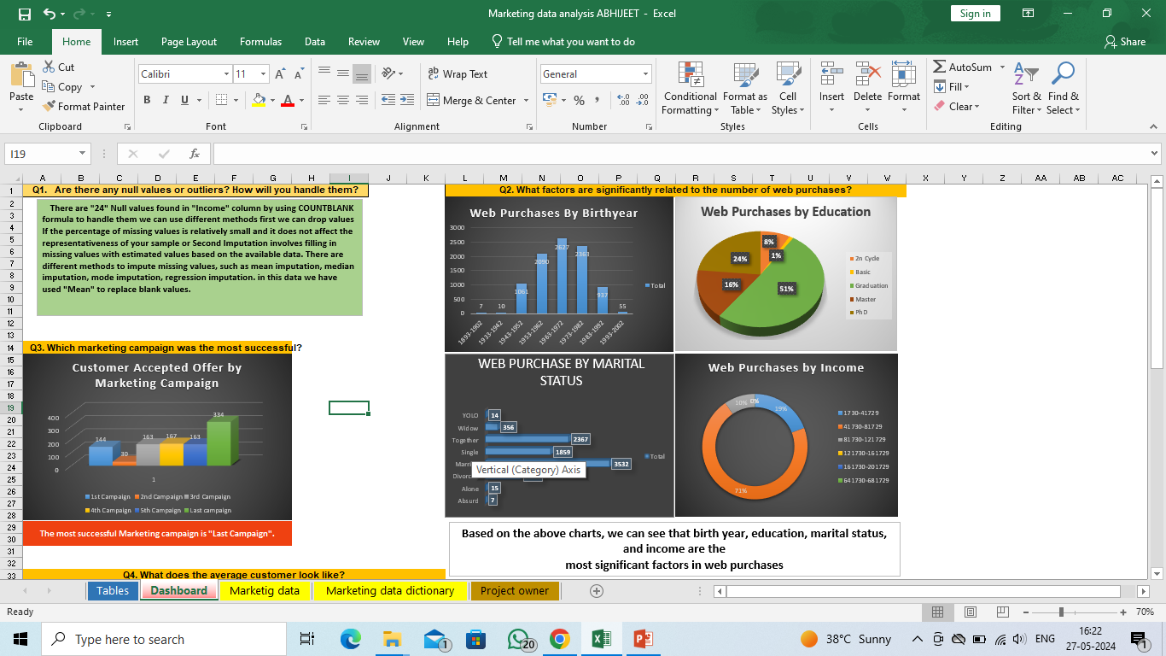
What factors are significantly related to the number of web purchases?

Slide 7
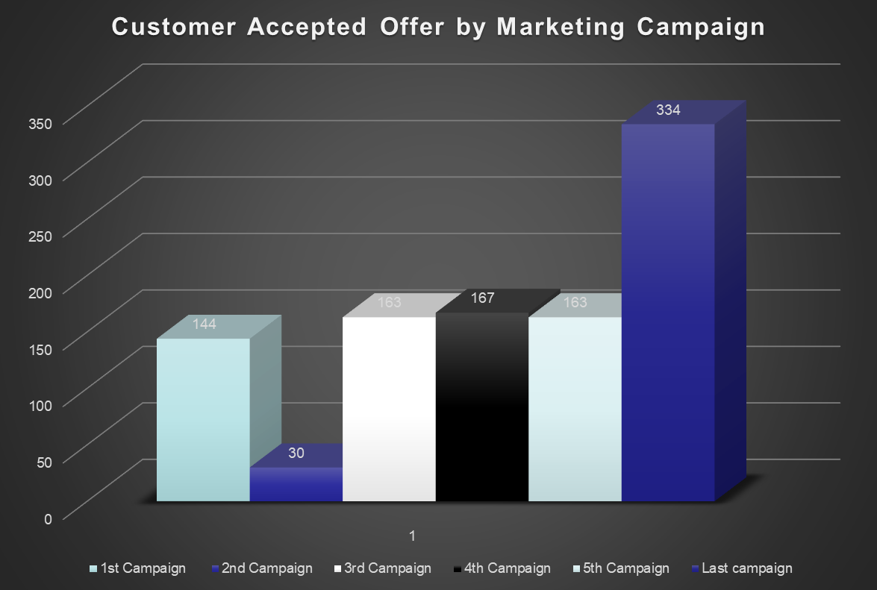
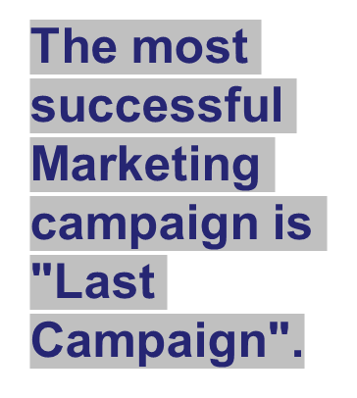
Which marketing campaign was the most successful?

Slide 8
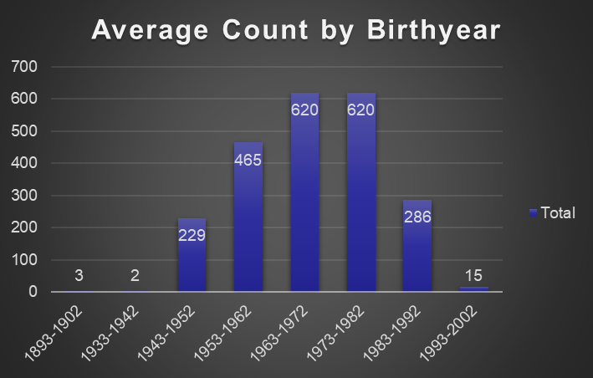
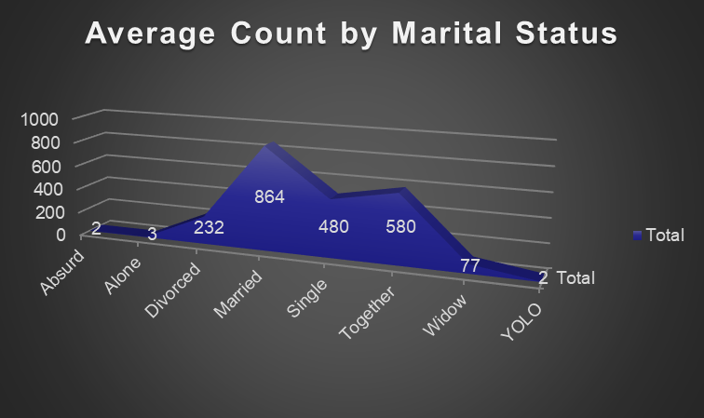
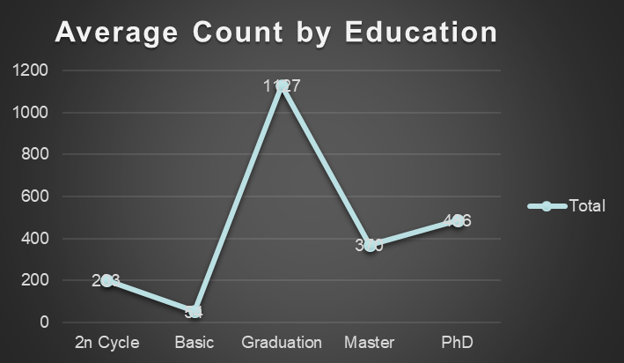
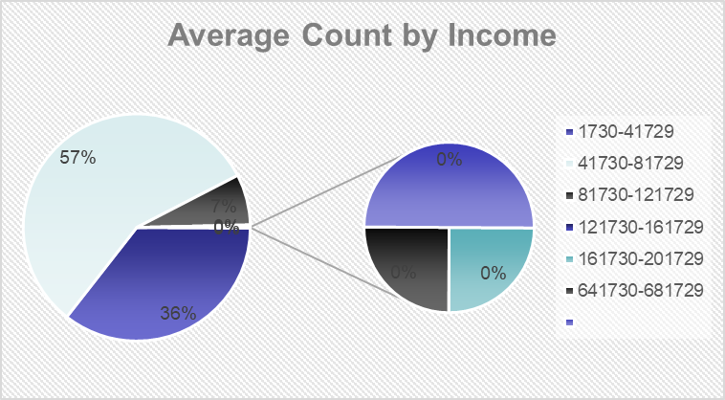
What does the average customer look like?

Slide 9
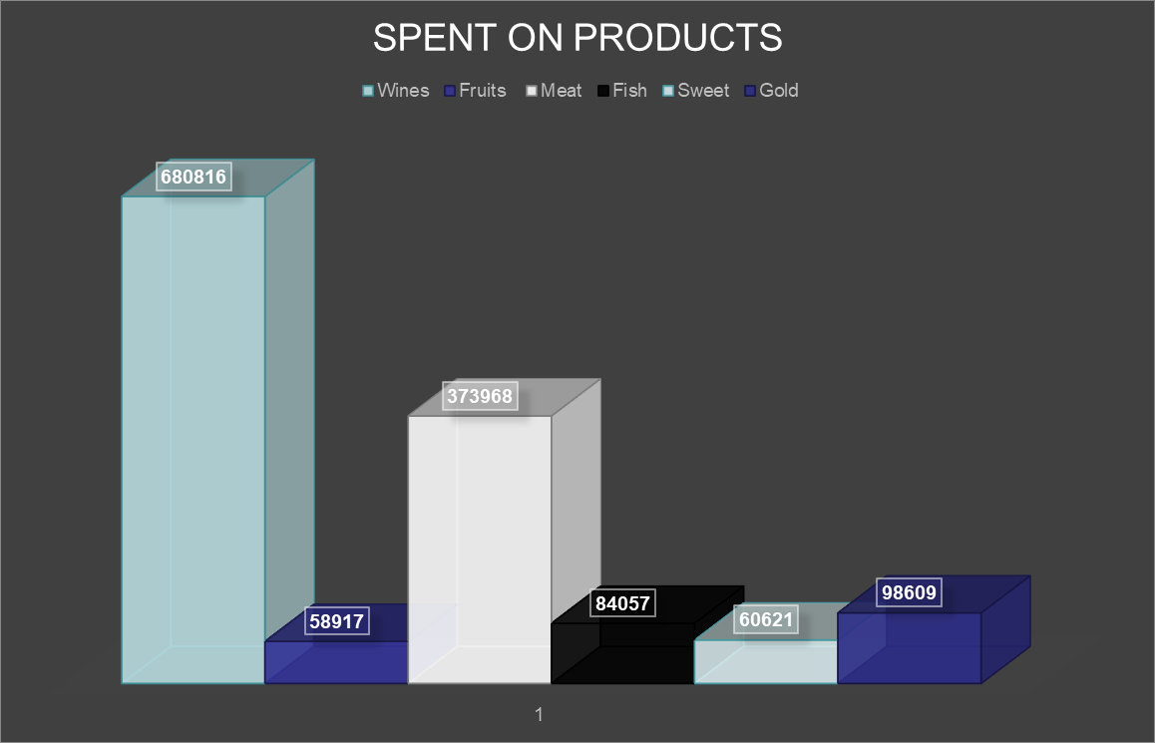
Which products are performing best?
Based on above chart The best Performing product is "WINES".

Slide 10
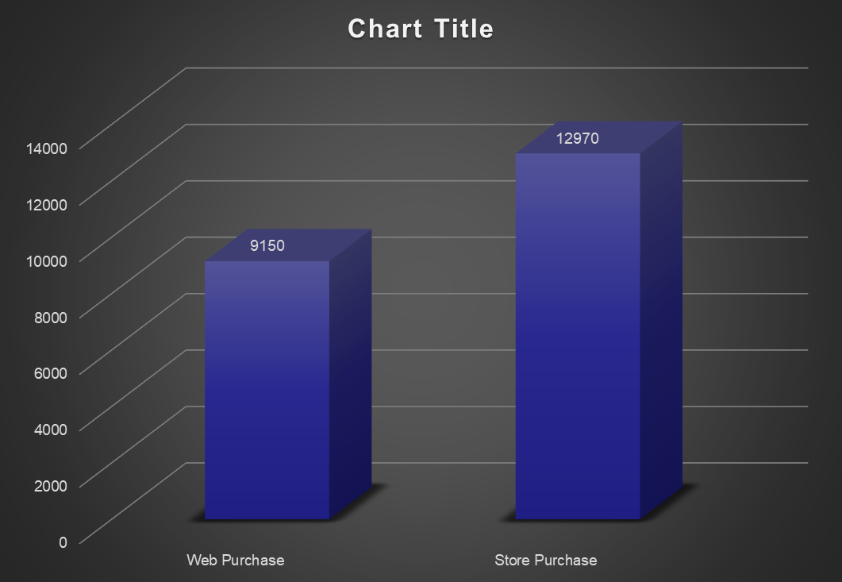
Which channels are underperforming?
Based on above shown chart The under performing Channel is "WEB PURCHASE".

Slide 11




THANK YOU
www.linkedin.com/in/abhijeet-ranjan-958760191
abhijeetr162@gmail.com
abhijeetranjan
https://peerlist.io/abhijeetranjan

